Slide 1

Computer Vision Quality Inspection for Thermo Fisher Scientific
Dale DeFord
Aug. 2024

Slide 2
Agenda
01
02
03
04
05
06
Business Problem
Exploratory Data Analysis
Predictive Modeling
Conclusions
Recommendation
Next Steps

Slide 3
Business Problem
01
Thermo Fisher Scientific (TFS) in Hillsboro OR manufactures Scanning Electron Microscopes (SEM). In production, Liquid Metal Ion Source (LMIS) units are imaged at a SEM and human inspected for quality issues. This process is costly and can be problematic due to varying human biases.
Goal:
Create an automated Computer Vision process that will accurately classify LMIS SEM images, thus reducing cost incurred in man-hours and quality problems due to varying human inspection biases.

Slide 4
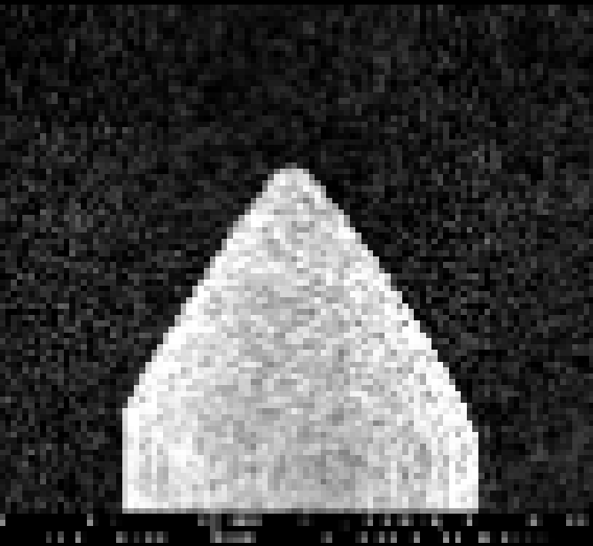
Data Analysis
02
LMIS SEM images were downloaded from TFS under Non-Disclosure Agreement (NDA).
7,019 grayscale SEM image files
Images labeled and sorted into 5 class folders
Details will be omitted or intentionally vague due to NDA
NOTE: SEM image has been intentionally scaled down to protect intellectual property
Notes:
- Each image was reviewed for potential re-classification based on dominant features

Slide 5
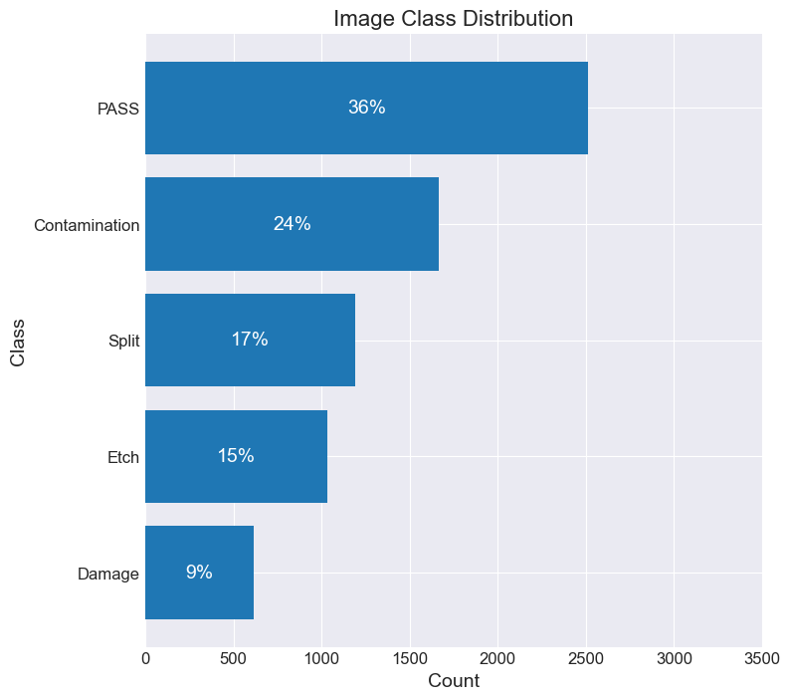
Image Data Class Distribution
NOTE: Many non-PASS images contained features from multiple classes
Imagine trying to classify CAT vs DOG, and many of your images have a CAT and a DOG!
Notes:
- Imbalance does exist, will be addressed in modeling

Slide 6
Predictive Modeling
03
BUSINESS REQUIREMENT:
Minimization of false-positives in the PASS class:
Top priority: avoid shipping non-PASS units to the customer.
False-Positive rate within PASS class must be < 1%
Scoring Metric: Accuracy

Slide 7
Baseline CNN Architecture
Feature Extraction Architecture:
Feature Maps 4
Feature Maps 3
Base Image
Augmented Image
Feature Maps 1
Feature Maps 2
SCALE +
AUGMENT
CONV 3x3
MAXPOOL
CONV 3x3
MAXPOOL
CONV 3x3
MAXPOOL
CONV 3x3
MAXPOOL
32
64
128
256
Input Layer
(relu)
Hidden Layer 1
(relu)
Output Layer (softmax)
1
1
1
Classification Architecture:
2
2
2
MULTICLASS CLASSIFICATION
MAXPOOL +
FLATTEN
…
…
…
512
512
4

Slide 8
Baseline Model Results
=======================
Training Accuracy: 92.2%
Test Accuracy: 87.3%
PASS FPR: 3.7%
=======================
PASS False-Pos
Notes:
- Paying special attention to the PASS column

Slide 9
Model Iteration Trends
Best Candidates
FPR
Adjusted <1%
Best Candidates
Minimize
Etch Class Added
Maximize
Experimenting mini AlexNet, ResNet50
Best Acc at <1% FPR
Fixed Colab batching Issue
Experimenting with 6 CONV

Slide 10
Best CNN Architecture
Feature Extraction Architecture:
Feature Maps 4
Feature Maps 3
Base Image
Augmented Image
Feature Maps 1
Feature Maps 2
SCALE +
AUGMENT
CONV 3x3
MAXPOOL
CONV 3x3
MAXPOOL
CONV 3x3
MAXPOOL
CONV 3x3
MAXPOOL
32
64
128
256
Input Layer
(relu)
Hidden Layer 1
(relu)
Hidden Layer 2 (relu)
Output Layer (softmax)
1
1
1
1
Classification Architecture:
2
2
2
2
MULTICLASS CLASSIFICATION
MAXPOOL +
FLATTEN
…
…
…
…
512
512
256
5
DROPOUT
(0.2)

Slide 11
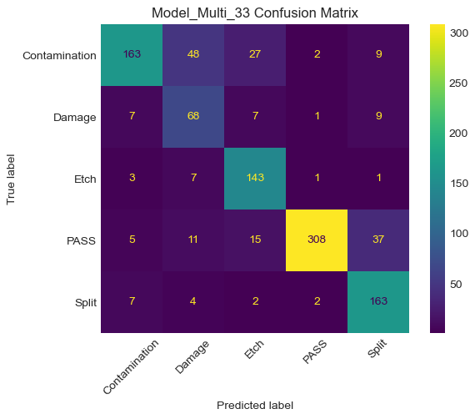
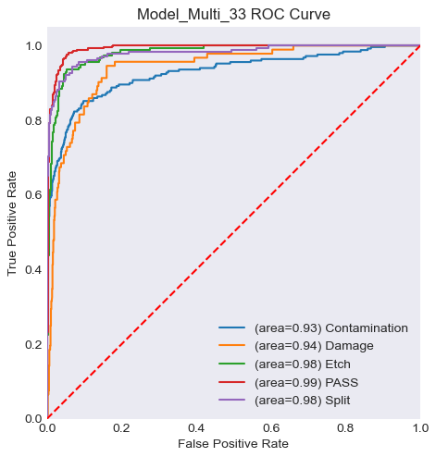
Best Model Results
========================================
Training Accuracy: 94.2%
Pre-FPR-Adjusted Test Accuracy: 83.5%
FPR-Adjusted Test Accuracy: 80.5%
PASS False-Pos Rate: 0.89%
========================================
PASS False-Pos
Notes:
308 images that humans would not need to look at in this case
647 non-pass images, 6 pass false-pos

Slide 12
Conclusions
04
Due to limited data sample size and crossover of classification types, model performance was capped at ~84 to 88% categorical accuracy
Final Model Metrics:
Accuracy: 80.5%
PASS False-Positive Rate: 0.89%

Slide 13
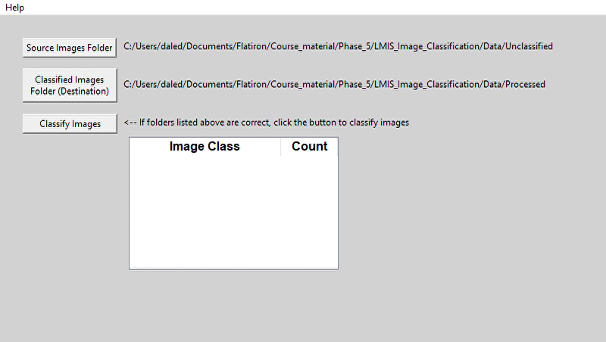
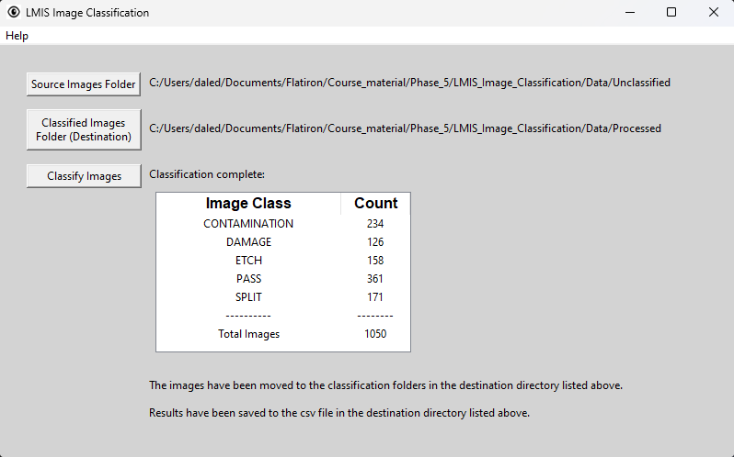
Recommendation
05
Initiate a production pilot evaluation of provided LMIS Image Classification executable and assess its performance vs. human; if accepted then discontinue human inspection of PASS class.
Runs the best model, sorts images into class folders for human review
Logs classification results to .cvs file
Notes:
- Mention production firewall

Slide 14
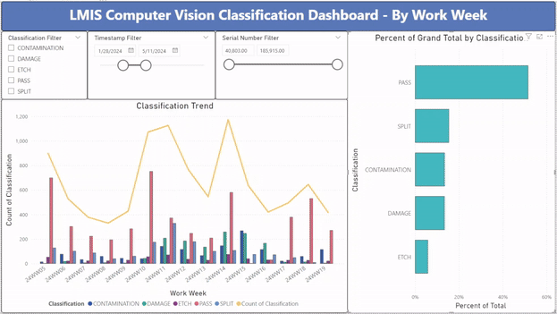
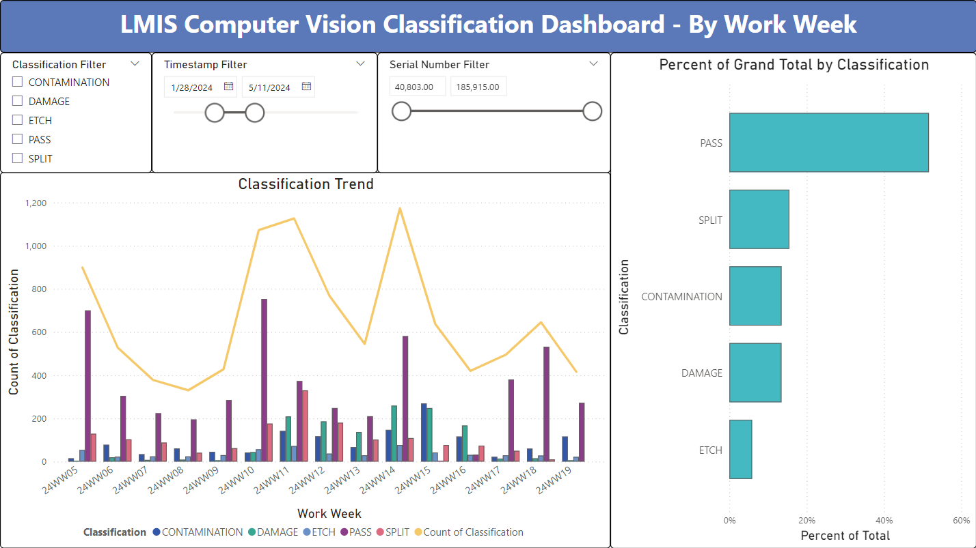
Recommendation
Monitor classification results via provided Power BI dashboard
Pulls production data from the csv log file
Real-time monitor of classification trends and distributions
Filter by class, date or unit serial number
NOTE: Fictitious data shown, not actual TFS production data

Slide 15
Next Steps
06
Continue to improve the model:
Need more data!
Subject matter expert labeling of many more images
Train with ‘clean’ samples, i.e., no images that could be more than 1 class
Continue attempting transfer learning architectures, i.e., ResNet50
If adequate model accuracy can be achieved, implement another production pilot to eliminate human inspection of all images

Slide 16


Thanks!
Questions? Please contact me at:
Dale DeFord
daledeford@gmail.com

